Slide 1

DEPARTMENT OF INFORMATION TECHNOLOGY
PROJECT PHASE 2 REVIEW
TEAM MEMBERS:
ABDUL PATHIAQ.A (22TH0102)
DAVID RAJ.M (22TH0112)
GOPINATH.G (22TH0116)
JAYAPRADAP.J (22TH0122)
PROJECT GUIDE:
Mrs.RANJANI.R
M.E.,MBA.,(Ph.D).,M.I.S.T.E.,
PROJECT COORDINATOR:
MR.J.MANI
HOD/IT (M.E.,Ph.D)
Notes:
null

Slide 2
AI-DRIVEN CYBER ANOMALY DETECTION AND SECURE AUDIT LOGGING FRAMEWORK
PROJECT REPORT PHASE II

Slide 3
AGENDA
ABSTRACT
INTRODUCTION AND PROBLEM STATEMENT
LITERATURE OVERVIEW
OBJECTIVES
EXISTING SYSTEM
PROPOSED SYSTEM
METHODOLOGY
SYSTEM ARCHITECTURE
IMPLEMENTATION
RESULTS
ADVANTAGES
LIMITATIONS
CONCLUSION
REFERENCES
.

Slide 4
ABSTRACT
Traditional intrusion detection systems rely on static signatures and predefined rules, failing against zero-day attacks and advanced persistent threats.
The proposed CAD framework addresses this by combining rule-based techniques with intelligent scoring to analyze user and network activities through preprocessing, keyword extraction, and contextual evaluation.
Dynamic Risk Scoring
Secure Audit Logging
Each event receives a score from 0–100, classified as low, medium, or high risk.
Tamper-resistant, structured event records supporting forensic analysis.
Real-Time Dashboard
Interactive web-based visualization
of anomalies, risk levels, and system
activity.

Slide 5
INTRODUCTION & PROBLEM STATEMENT
Why Traditional IDS Falls Short
The CAD Solution
CAD bridges the gap between traditional detection and advanced AI-driven security by integrating:
Signature-based systems depend on known attack patterns, making them ineffective against zero-day exploits, insider threats, and APTs.
Real-time behavioral anomaly detection
Multi-stage preprocessing and feature extraction
Dynamic risk scoring and classification
Secure, structured audit logging
Interactive monitoring dashboard
Cannot detect unknown or evolving attacks
No dynamic risk prioritization
Lack tamper-resistant logging
Detection and logging rarely integrated

Slide 6
LITERATURE OVERVIEW
Significant advancements in AI/ML-based anomaly detection have shaped the field.
Key findings from recent research include:
Hybrid Deep Learning (Almuhanna & Dardouri, 2025)
Autoencoders, graph neural networks, and ensemble learning
combined for improved detection performance.
Encrypted Traffic Detection (2025)
Self-supervised learning identifies hidden patterns without labeled datasets, improving detection in secure environments.
Blockchain + Deep Neural Networks (2025)
IoT security enhanced via blockchain integration .it improves
data integrity but adds system complexity.
LSTM & Transformer Logs (Chourasiya et al., 2025)
Log-based anomaly detection for cyber forensics high accuracy but requires
large datasets and compute resources.

Slide 7
OBJECTIVES
01
02
03
Anomaly-Based Detection
Dynamic Risk Scoring
Secure Audit Logging
Analyze user and network behavior in real time to identify suspicious activities.
Classify each activity as low, medium, or high risk on a 0–100 scale for efficient threat prioritization.
Record all events in a tamper-resistant, structured format supporting transparency and forensic investigation.
04
05
Interactive Dashboard
Scalable & Modular Design
Provide real-time monitoring and visualization to improve situational awareness for administrators.
Enable future integration of ML models, deep learning algorithms, and blockchain-based security mechanisms.

Slide 8
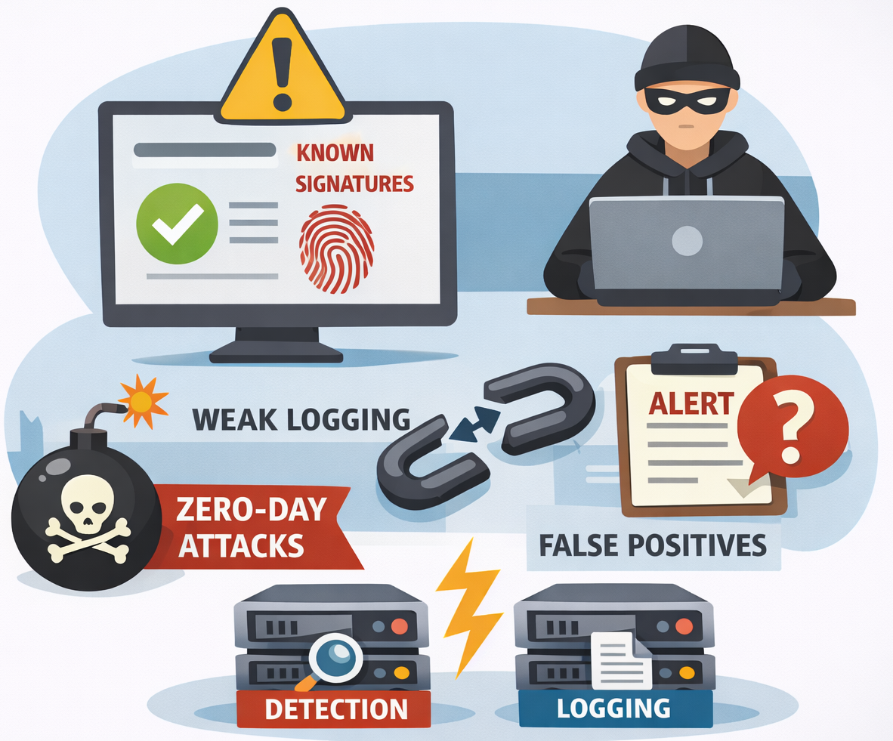
EXISTING SYSTEM
Uses signature-based and rule-based detection, so it identifies only known threats.
Cannot detect zero-day attacks and results in high false positives with weak logging.
Does not provide dynamic risk scoring, making threat prioritization difficult.
Detection and logging are handled separately, reducing overall system efficiency.
Limited adaptability to new and evolving cyber attack patterns.
Not scalable for handling large and complex network environments effectively
Lacks real-time intelligent analysis, resulting in delayed threat detection.

Slide 9
PROPOSED SYSTEM
CAD (AI-Driven Cyber Anomaly Detection and Secure Audit Logging Framework), is designed as an intelligent cybersecurity solution that uses a behavior-based approach to detect anomalies in real time.
The modular and scalable design of CAD allows easy deployment and future integration with advanced technologies like machine learning, deep learning, and blockchain, making it an effective and reliable cybersecurity framework
Behavior-Based Detection – Identifies anomalies by detecting deviations from normal user and system behavior.
Real-Time Monitoring – Continuously analyzes activities, network events, and system interactions instantly.
Preprocessing Techniques – Uses normalization, keyword extraction, and contextual analysis for accurate detection.
Risk Scoring System – Assigns a score (0–100) and classifies threats into low, medium, and high risk.
Secure Audit Logging – Maintains tamper-resistant logs with timestamps and event details for security and analysis.
Interactive Dashboard & Scalability – Provides real-time visualization and supports future upgrades like AI, ML, and blockchain
Detection Engine – Core component that processes data and detects potential cyber threats.

Slide 10
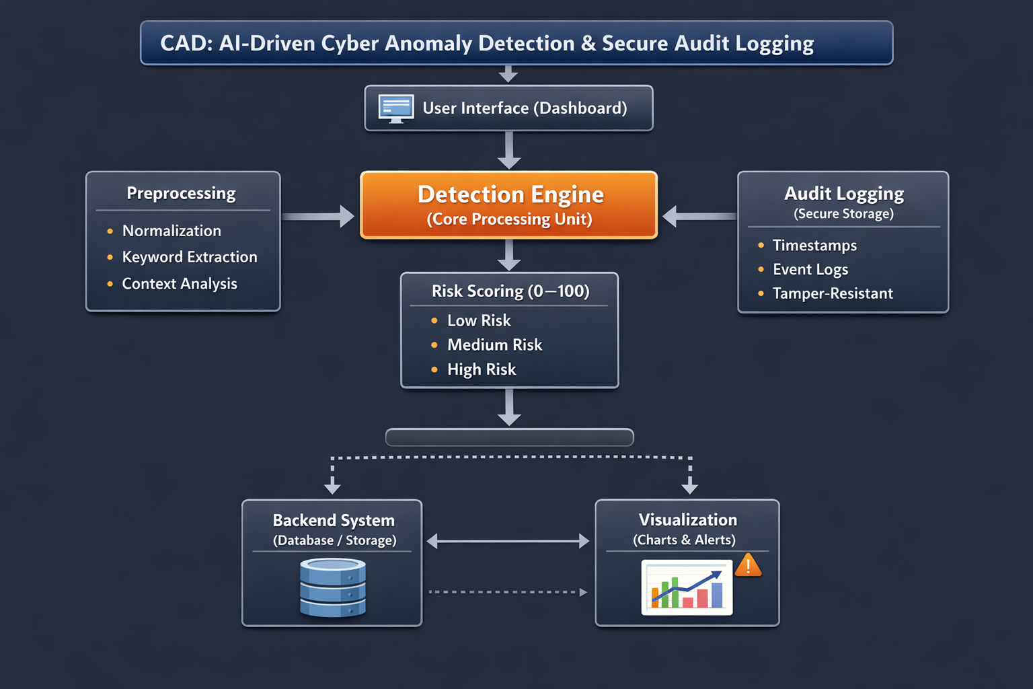
It improves threat detection through dynamic risk scoring and ensures data security with tamper-resistant audit logging.
The system is scalable, easy to deploy, and suitable for future enhancements, making it a reliable solution for modern cyber threat management

Slide 11
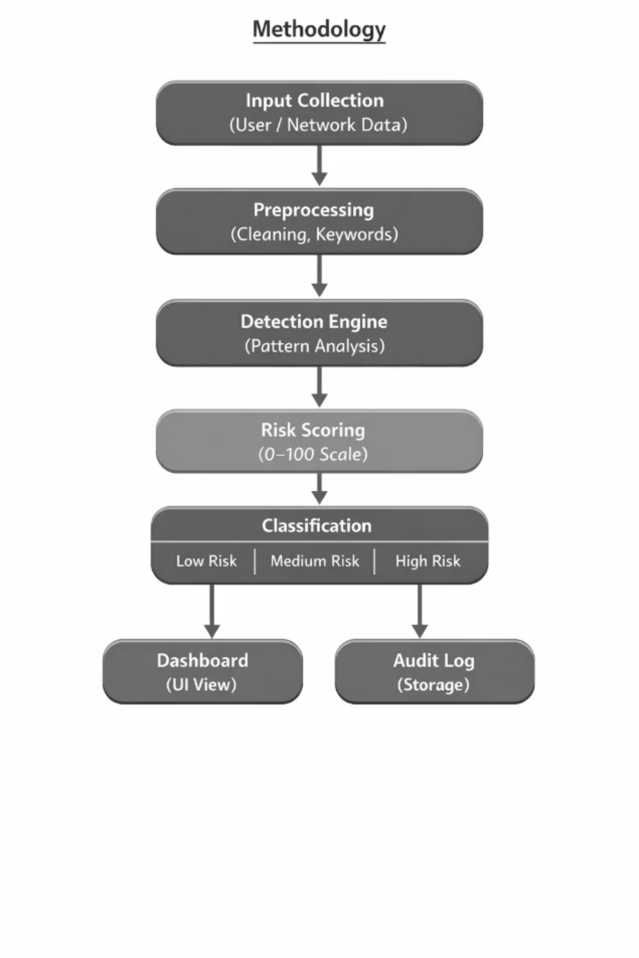
METHODOLOGY
CAD follows a structured, end-to-end pipeline from data collection to visualization. Each stage feeds seamlessly into the next, ensuring real-time analysis with minimal latency.
Input Collection: Login attempts, command executions, network events
Preprocessing: Cleaning, normalization, keyword extraction
Detection Engine: Rule-based and behavior-driven pattern analysis
Risk Scoring: Dynamic 0–100 score based on keyword intensity, frequency, and context
Classification: Low / Medium / High risk categories
Output: Dashboard visualization + tamper-resistant audit log

Slide 12
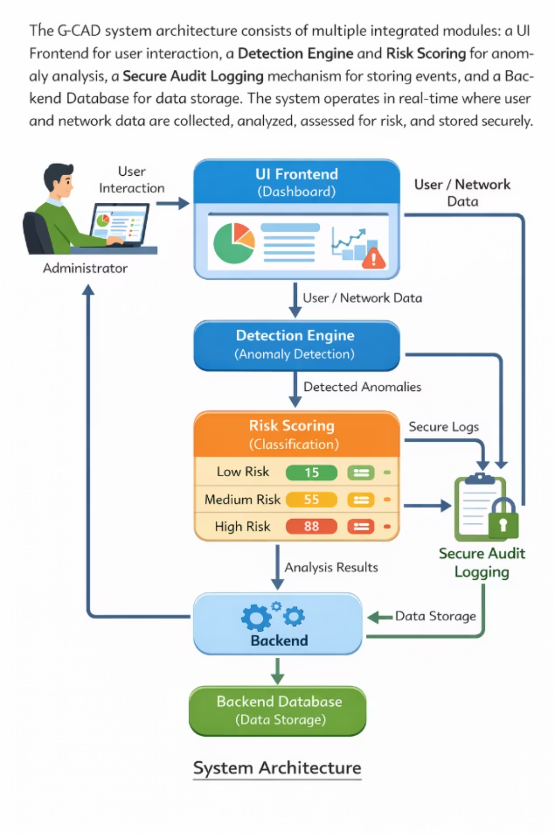
SYSTEM ARCHITECTURE
CAD's modular architecture integrates five key components into a seamless
data flow — from user interaction to secure storage.
UI Frontend
Backend & Database
1
Interactive dashboard for administrator input
and real-time monitoring.
5
Manages inter-module communication and
long-term data storage.
Detection Engine
2
Behavior-based anomaly identification; detects deviations from normal activity.
Risk Scoring Module
3
Assigns dynamic scores and classifies events
into Low / Medium / High risk.
Secure Audit Logging
4
Tamper-resistant structured storage with timestamps and classification labels.

Slide 13
IMPLEMENTATION
Frontend
HTML, CSS, and JavaScript deliver a responsive, real-time monitoring
interface with charts and risk indicators.
Backend
Python with Flask handles request processing, module communication,
and RESTful API data exchange.
1
Data Storage
MongoDB optionally integrated for structured audit log storage and
long-term system data management.
Modular Design
Each component — detection, scoring, logging — is independent yet
interconnected, simplifying maintenance and future upgrades.

Slide 14
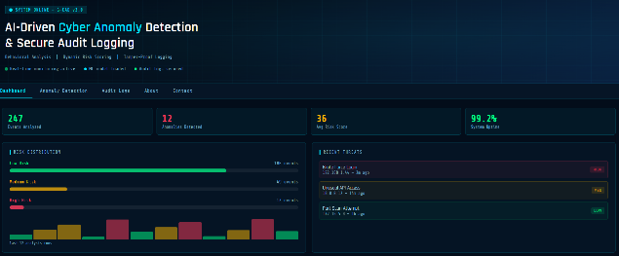

RESULTS
CAD was tested using simulated user inputs representing both normal and suspicious behavior.
The system accurately flagged high-risk events while minimizing false alerts for legitimate activity.
247
12
99.2%
Events Analyzed
Functions Detected
System Uptime
Total events processed during testing
Anomalous activities correctly identified
Reliable real-time performance & evaluation
Below are screenshots from the live CAD dashboard demonstrating the home view, anomaly detection, brute force login detection (risk score: 73 — High Risk), and normal file access (risk score: 33 — Low Risk).
Home page :
Anomaly Detection:

Slide 15
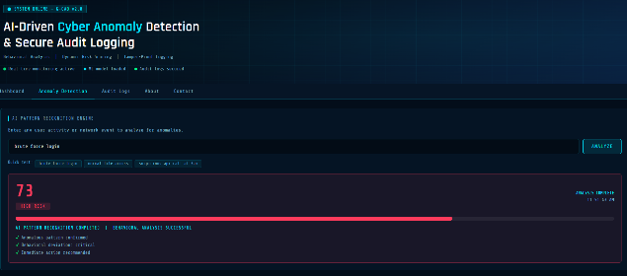
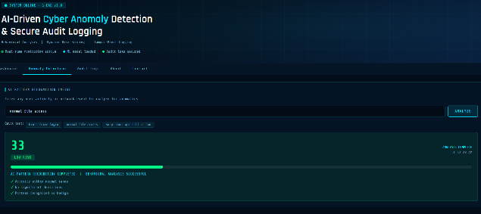
Brute Force Login:
Normal File Access:
The system can differentiate normal and suspicious behavior with good accuracy.
High-risk events like brute force login are flagged, while normal activities are marked as low risk.
The framework supports real-time analysis and shows results instantly on the dashboard.
The system provides clear visual outputs such as charts, risk indicators, and alerts for easy monitoring.
All events are stored in audit logs, which helps in traceability, historical analysis, and future investigation
CAD detects anomalous activities using behavioral analysis and dynamic risk scoring.

Slide 16
ADVANTAGES OF CAD SYSTEM
Real-time anomaly detection – Identifies threats instantly without delay
Detects unknown attacks – Works beyond signature-based methods (zero-day detection)
Dynamic risk scoring – Assigns risk levels (Low, Medium, High) for better prioritization
Reduced false positives – Improves accuracy compared to traditional systems
Behavior-based analysis – Detects deviations in user and system activities
Secure audit logging – Stores data in a tamper-resistant and structured format
Interactive dashboard – Provides clear visualization for easy monitoring
Scalable and flexible – Can be upgraded with AI, ML, and blockchain technologies

Slide 17
LIMITATIONS OF CAD SYSTEM
Rule-based dependency – Limited intelligence without advanced ML models
Not fully tested in real-world environments – Mostly based on simulated data
Limited adaptability – May struggle with highly complex attack patterns
No deep learning integration – Reduces detection capability for advanced threats
Performance depends on input quality – Poor data affects accuracy
Scalability challenges – Needs optimization for large-scale deployment
Lack of automation in response – Only detects, does not automatically response

Slide 18
CONCLUSION
CAD presents a comprehensive, scalable solution that overcomes the limitations of traditional signature-based systems by integrating behavior-based anomaly detection, dynamic risk scoring, and secure audit logging into a unified framework.
Current Strengths :
Real-time detection, efficient risk classification, transparent logging, and an intuitive dashboard — all in a lightweight, deployable package.
Future Enhancements :
Integration of advanced ML/deep learning models, real-time network traffic analysis, and blockchain-based security mechanisms to further improve accuracy and scalability.
Key Takeaway: CAD represents a promising step toward intelligent, adaptive cybersecurity — bridging the gap between traditional rule-based systems and next-generation AI-driven threat detection.

Slide 19
REFERENCES
H. Rahman and Y. O. Mohamed, “Power system cybersecurity: A survey,” IEEE Access, vol. 8, pp. 111576–111588, 2020.
R. D. L. et al., “Deep learning for cybersecurity: State-of-the-art and challenges,” IEEE Access, vol. 8, pp. 53841–53870, 2020.
B. Poudel and C.-H. Kim, “Secure and efficient machine learning for smart grids,” IEEE Trans. Smart Grid, vol. 11, no. 6, pp. 5005–5013, 2020.
L. Wang, H. Jin, and S. Yang, “LSTM-based detection of cyber-attacks in smart grids,” in Proc. IEEE PESGM, 2020.
Y. Liu et al., “Deep learning for cybersecurity anomaly detection: A survey,” IEEE Trans. Dependable Secure Comput., vol. 18, pp. 2224–2241, 2021.
K. Zhao et al., “A survey of anomaly detection methods for IoT systems,” IEEE Access, vol. 9, pp. 128269–128290, 2021.
A. Sahu et al., “Multi-source data fusion for cyberattack detection,” IEEE Access, vol. 9, pp. 112456–112470, 2021.
Y. Farrukh et al., “Supervised ML approach for cyber attack detection,” in Proc. IEEE NAPS, 2021.
V. S. K. et al., “SHAP-enhanced intrusion detection system,” in Proc. ACM SAC, 2023.
S. Hussain et al., “Hybrid methodology to secure smart grids,” Scientific Reports, vol. 13, 2023.

Slide 20
THANK YOU…!

